Slide 1
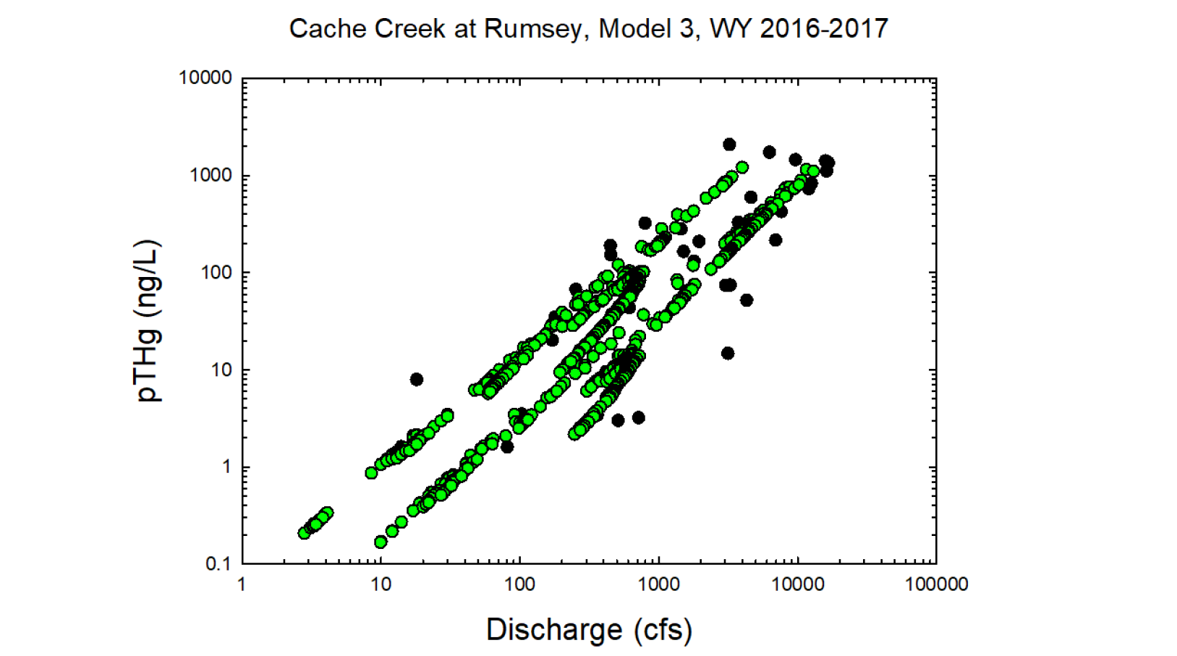
Black circles = Observed values
Green circles = Modeled values

Slide 2
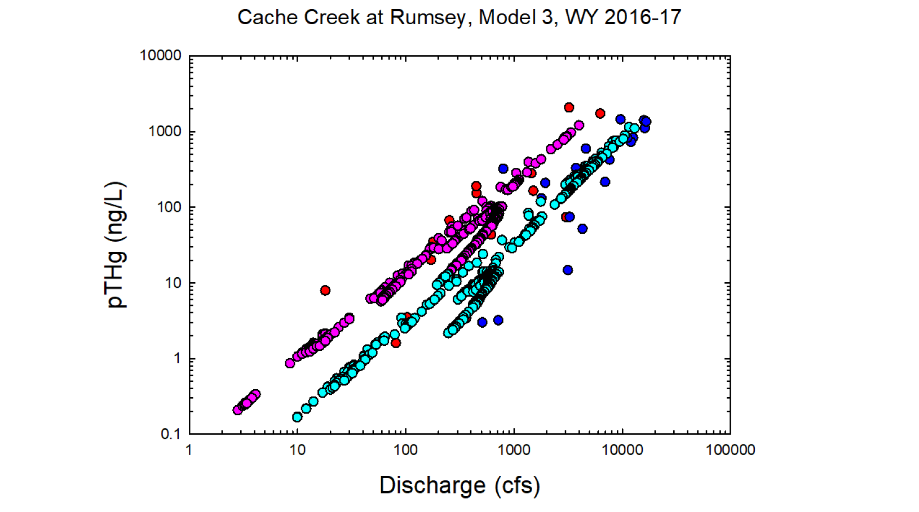
Red = Observed wy2016
Dk. Blue = Observed wy2017
Pink = Modeled wy2016
Lt. Blue= Modeled wy2017

Slide 3
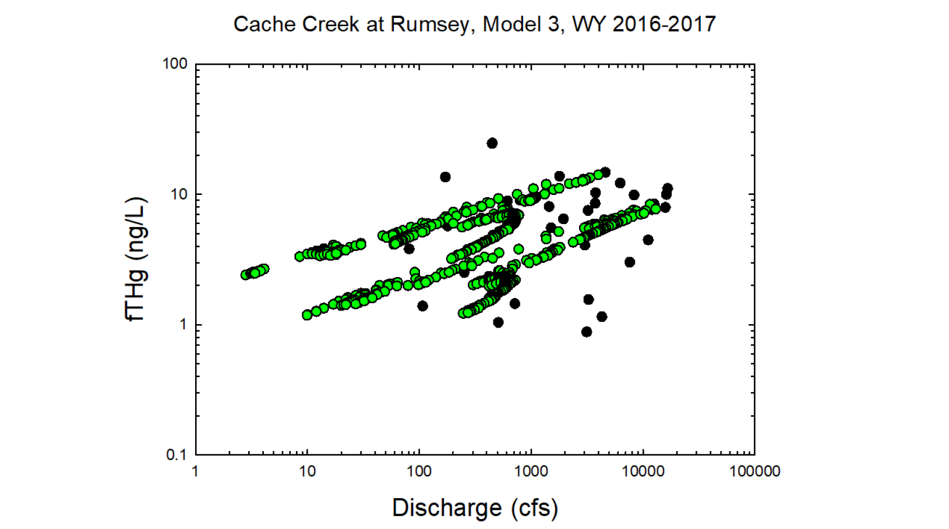
Black circles = Observed values
Green circles = Modeled values

Slide 4
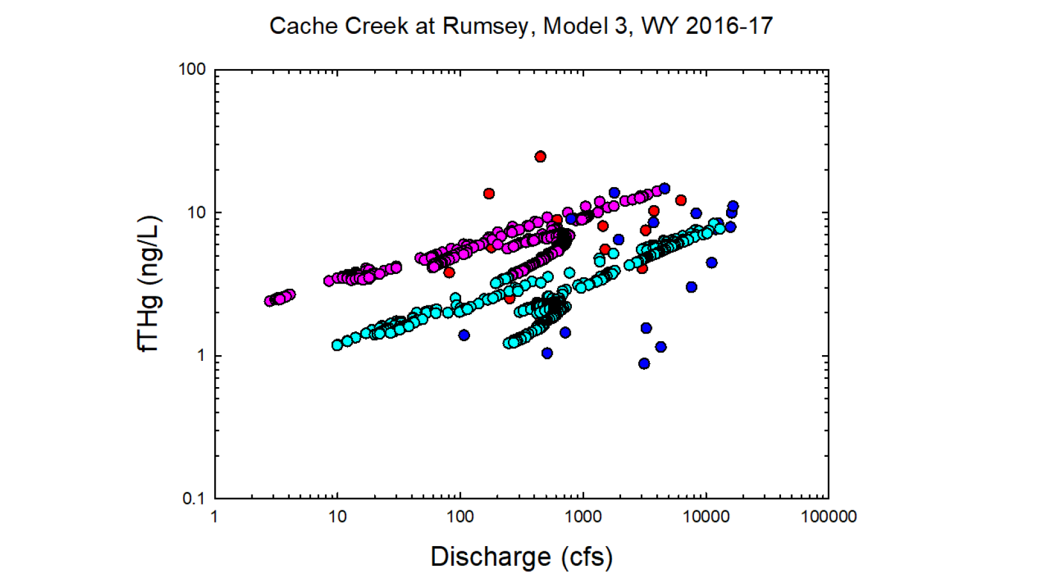
Red = Observed wy2016
Dk. Blue = Observed wy2017
Pink = Modeled wy2016
Lt. Blue= Modeled wy2017

Slide 5
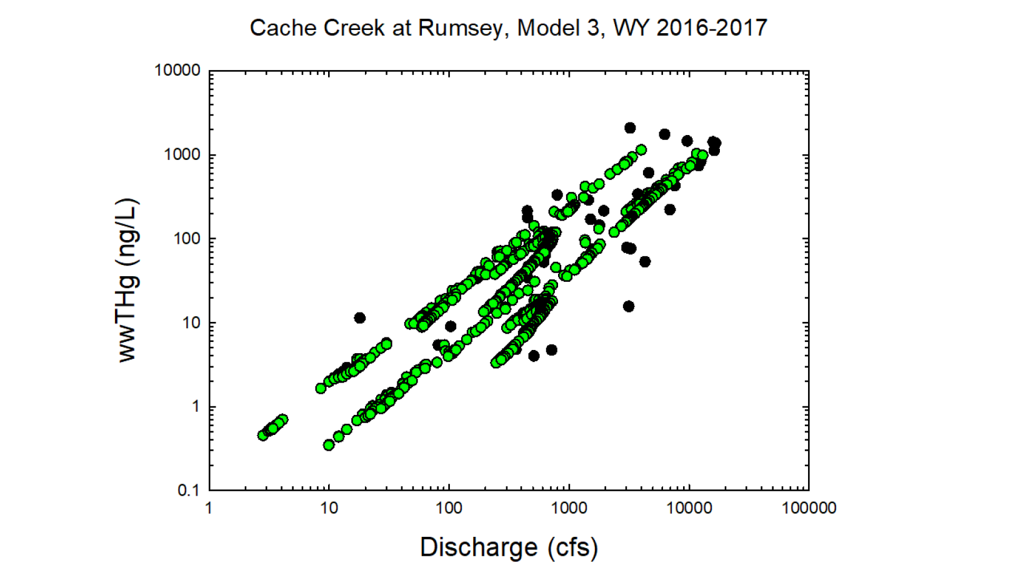
Black circles = Observed values
Green circles = Modeled values

Slide 6
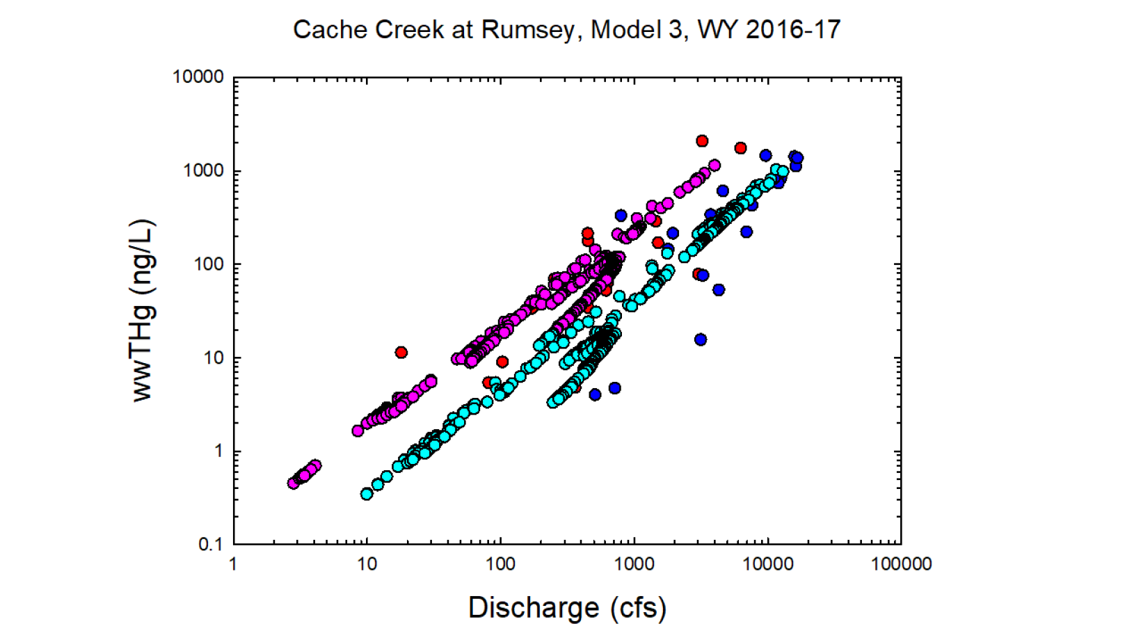
Red = Observed wy2016
Dk. Blue = Observed wy2017
Pink = Modeled wy2016
Lt. Blue= Modeled wy2017

Slide 7
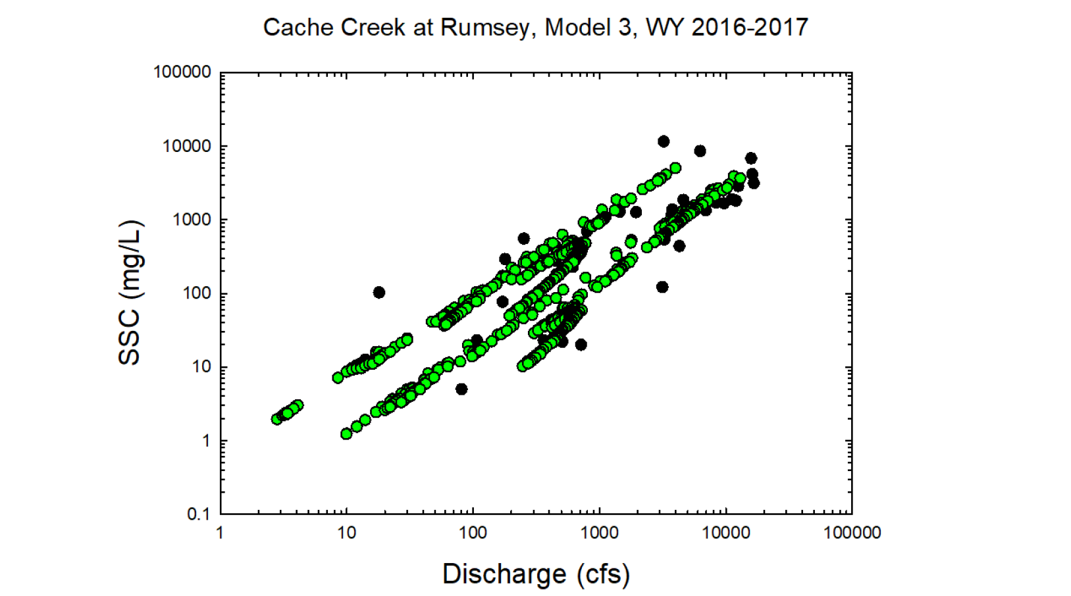
Black circles = Observed values
Green circles = Modeled values

Slide 8
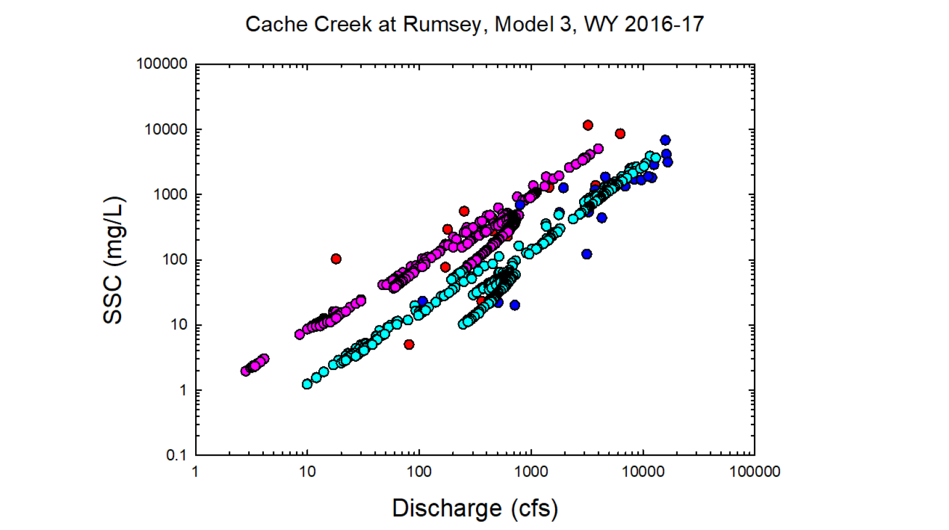
Red = Observed wy2016
Dk. Blue = Observed wy2017
Pink = Modeled wy2016
Lt. Blue= Modeled wy2017

Slide 9
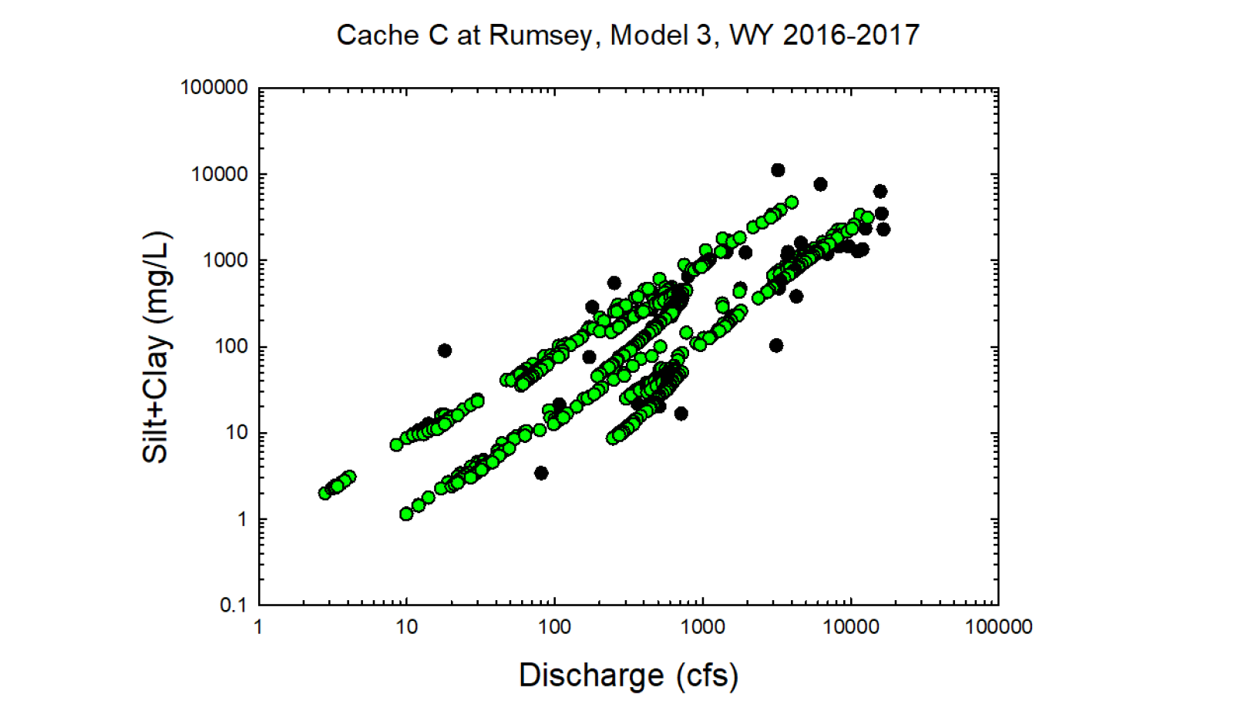
Black circles = Observed values
Green circles = Modeled values

Slide 10
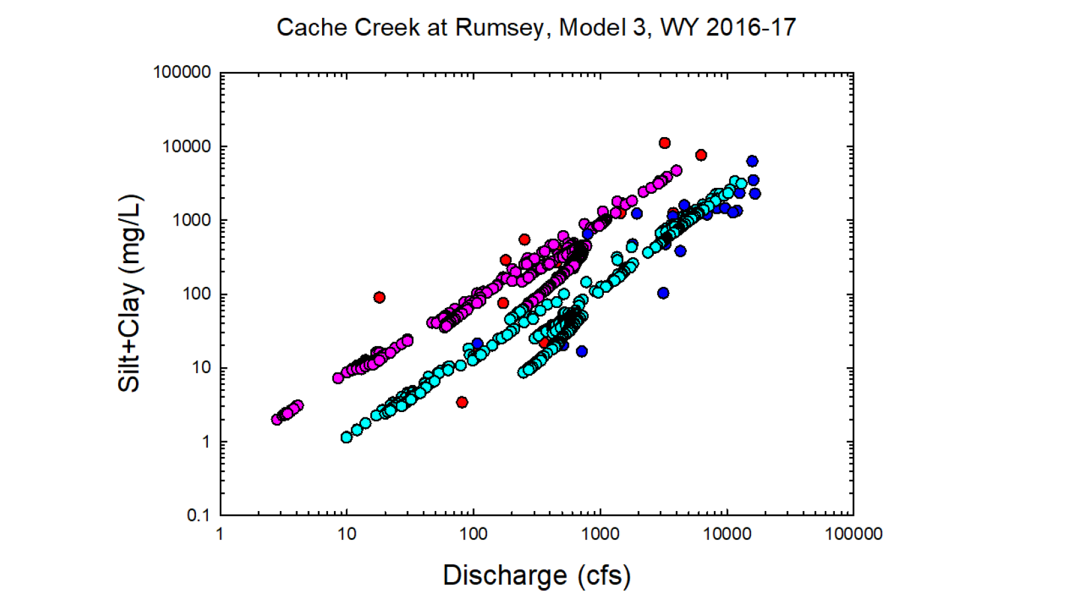
Red = Observed wy2016
Dk. Blue = Observed wy2017
Pink = Modeled wy2016
Lt. Blue= Modeled wy2017

Slide 11
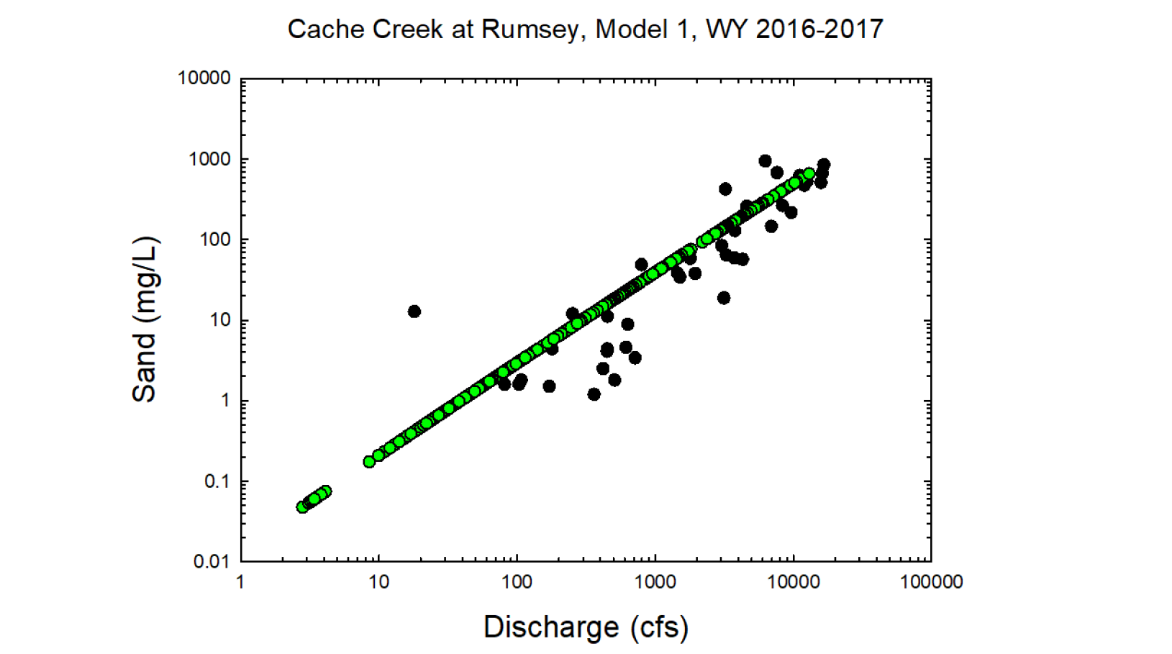
Black circles = Observed values
Green circles = Modeled values

Slide 12
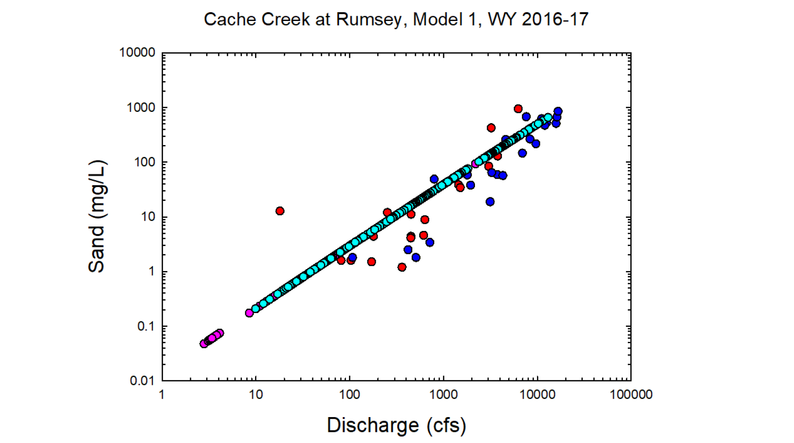
Red = Observed wy2016
Dk. Blue = Observed wy2017
Pink = Modeled wy2016
Lt. Blue= Modeled wy2017

Slide 13
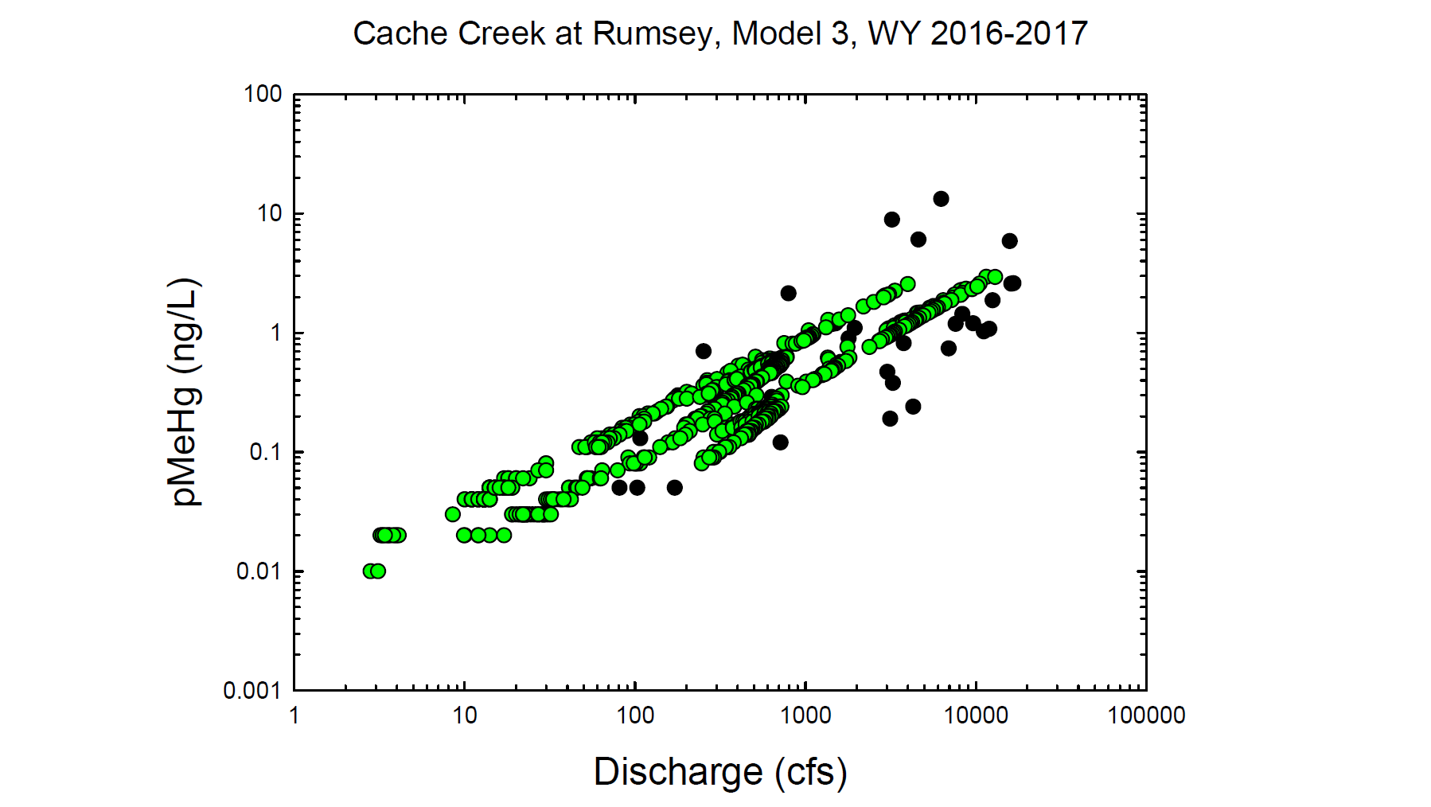
Black circles = Observed values
Green circles = Modeled values

Slide 14
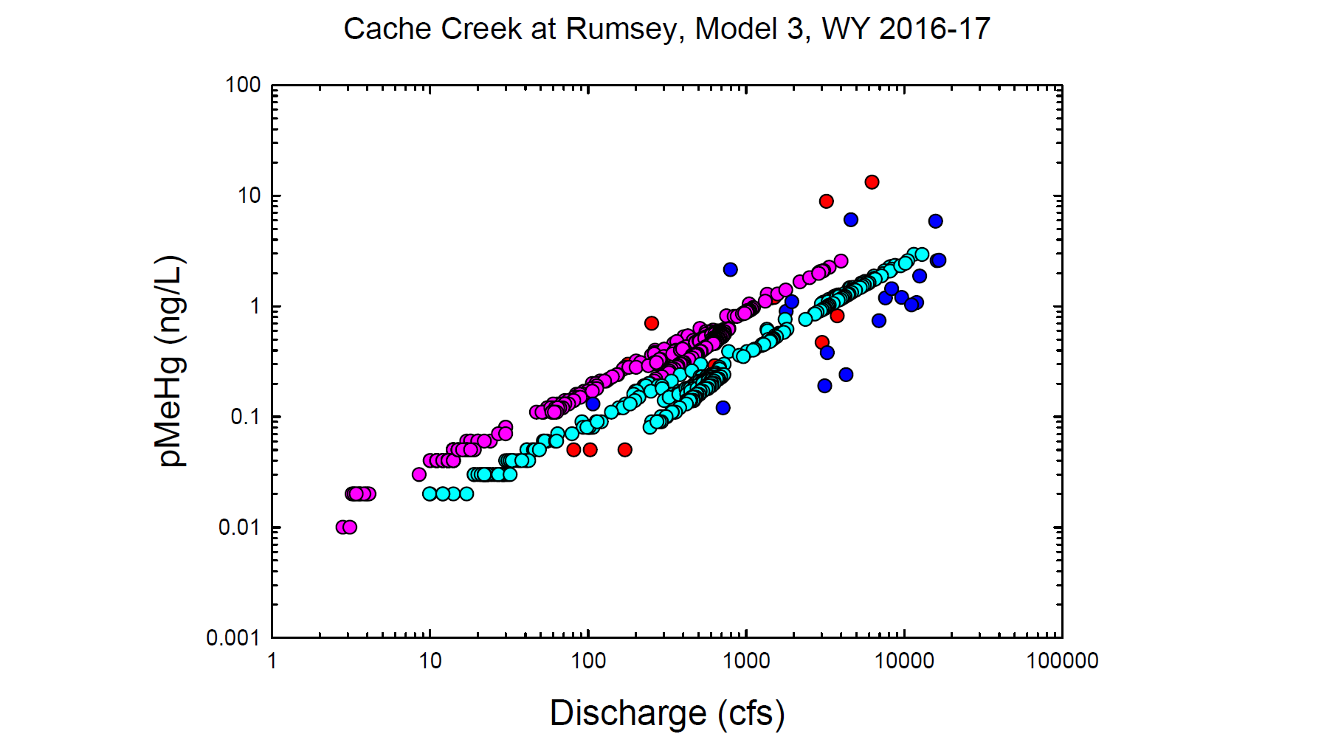
Red = Observed wy2016
Dk. Blue = Observed wy2017
Pink = Modeled wy2016
Lt. Blue= Modeled wy2017

Slide 15
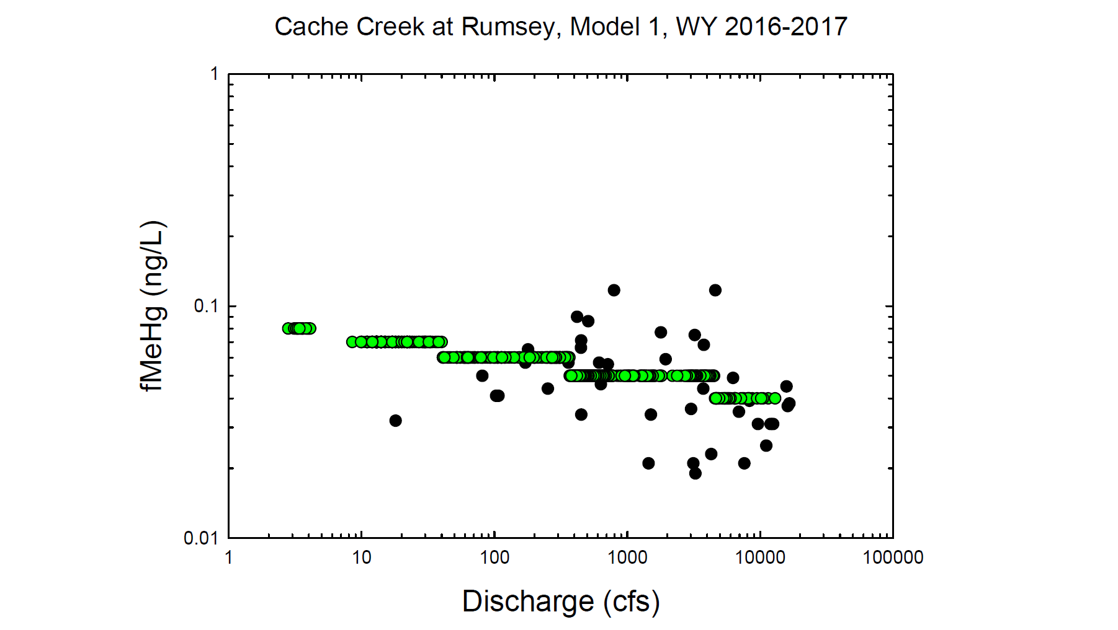
Black circles = Observed values
Green circles = Modeled values

Slide 16
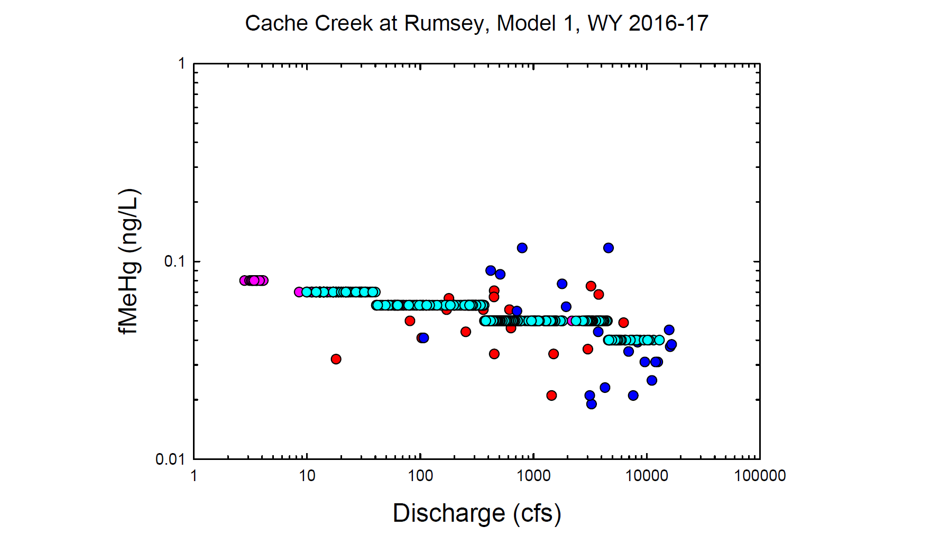
Red = Observed wy2016
Dk. Blue = Observed wy2017
Pink = Modeled wy2016
Lt. Blue= Modeled wy2017

Slide 17
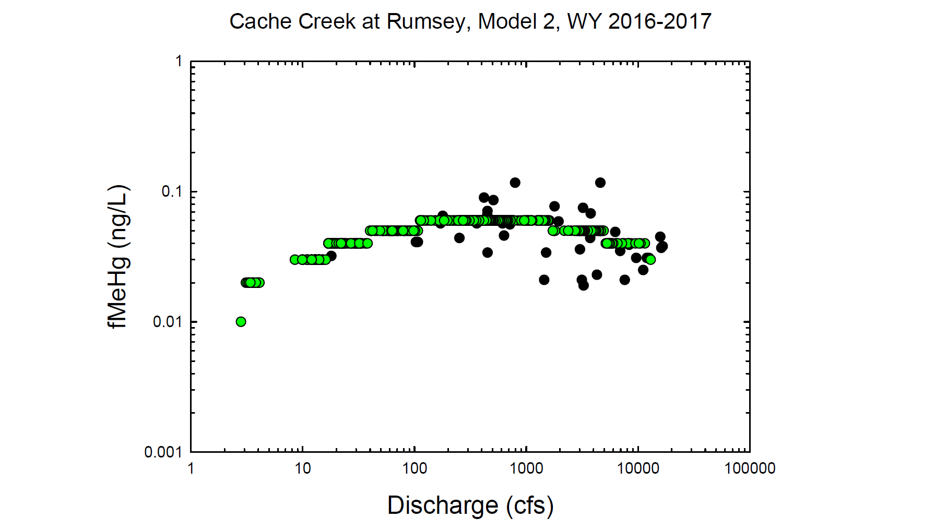
Black circles = Observed values
Green circles = Modeled values

Slide 18
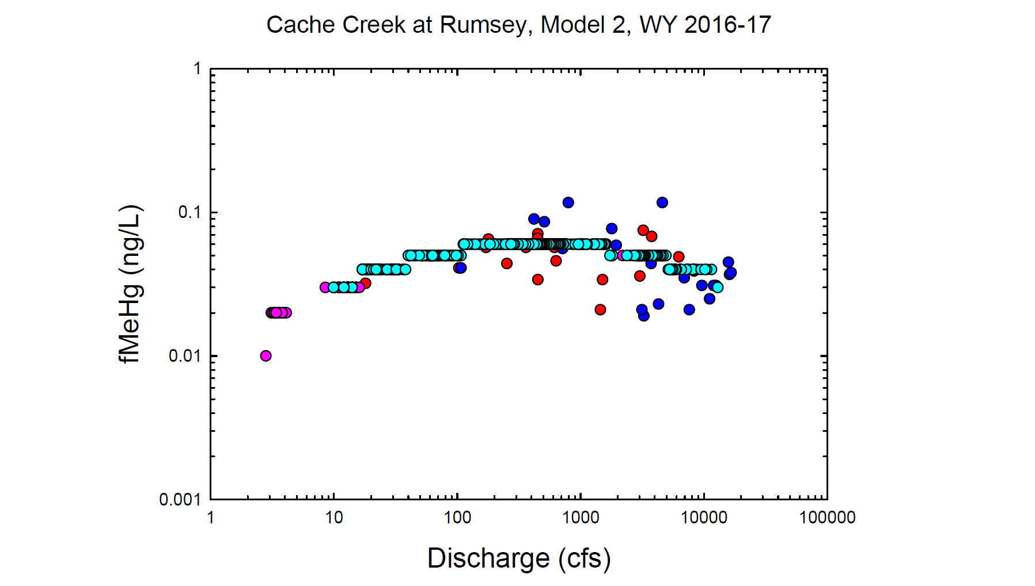
Red = Observed wy2016
Dk. Blue = Observed wy2017
Pink = Modeled wy2016
Lt. Blue= Modeled wy2017

Slide 19
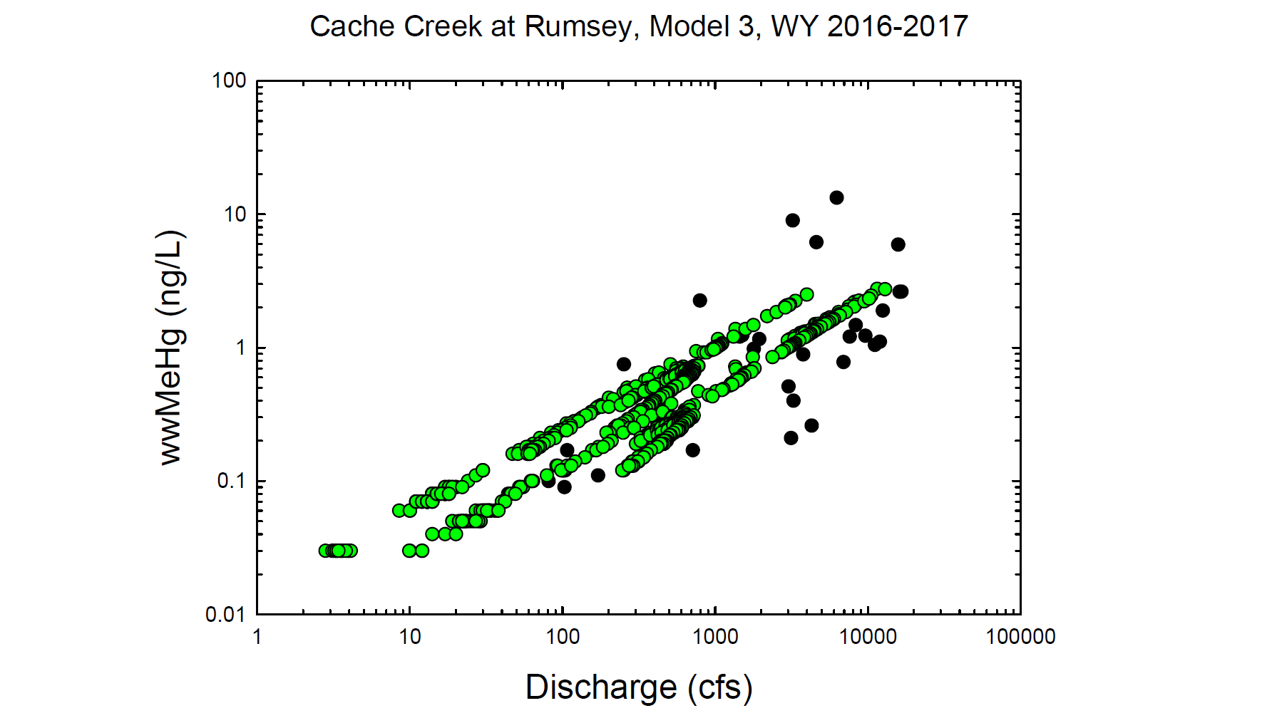
Black circles = Observed values
Green circles = Modeled values

Slide 20
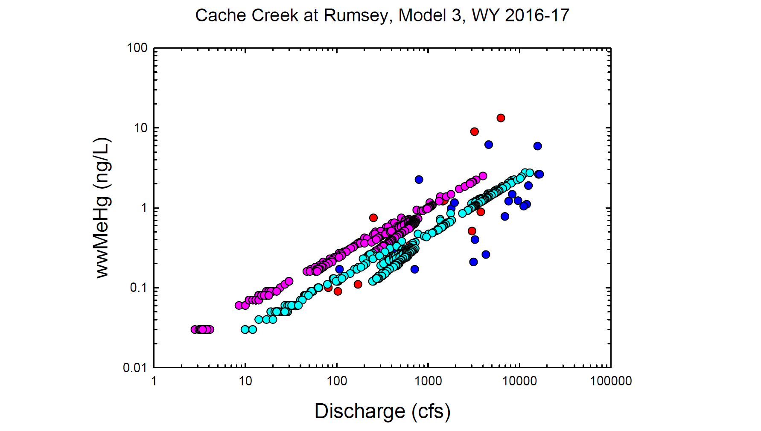
Red = Observed wy2016
Dk. Blue = Observed wy2017
Pink = Modeled wy2016
Lt. Blue= Modeled wy2017

Slide 21
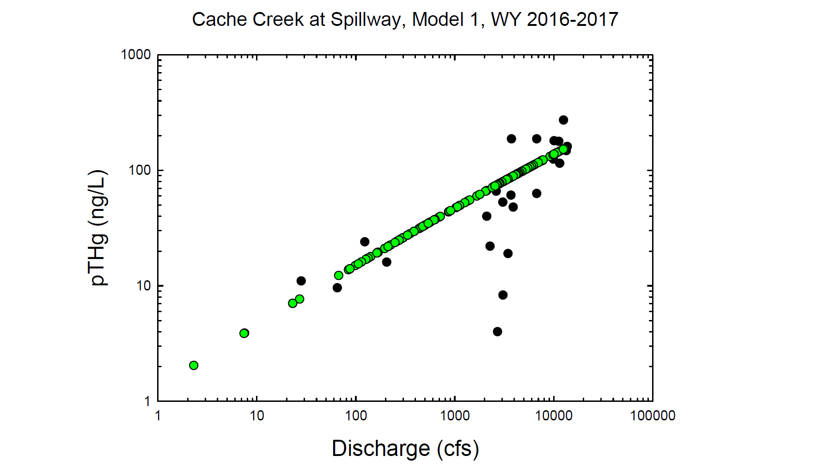
Black circles = Observed values
Green circles = Modeled values

Slide 22
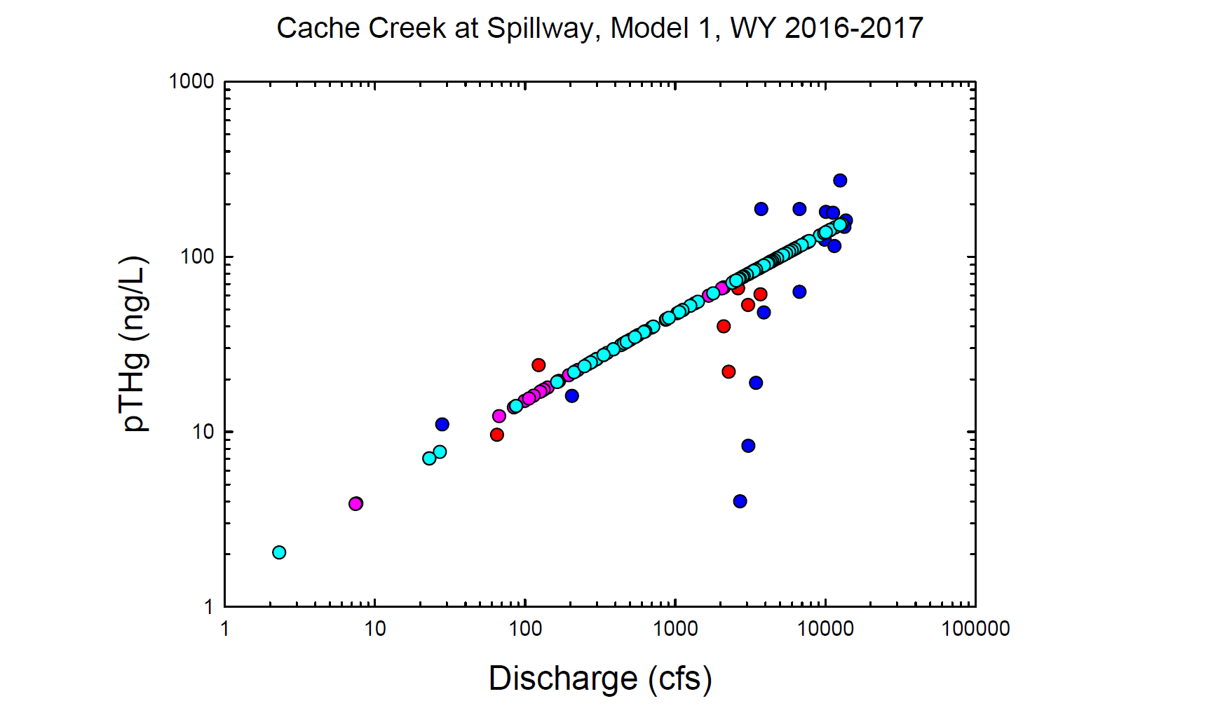
Red = Observed wy2016
Dk. Blue = Observed wy2017
Pink = Modeled wy2016
Lt. Blue= Modeled wy2017

Slide 23
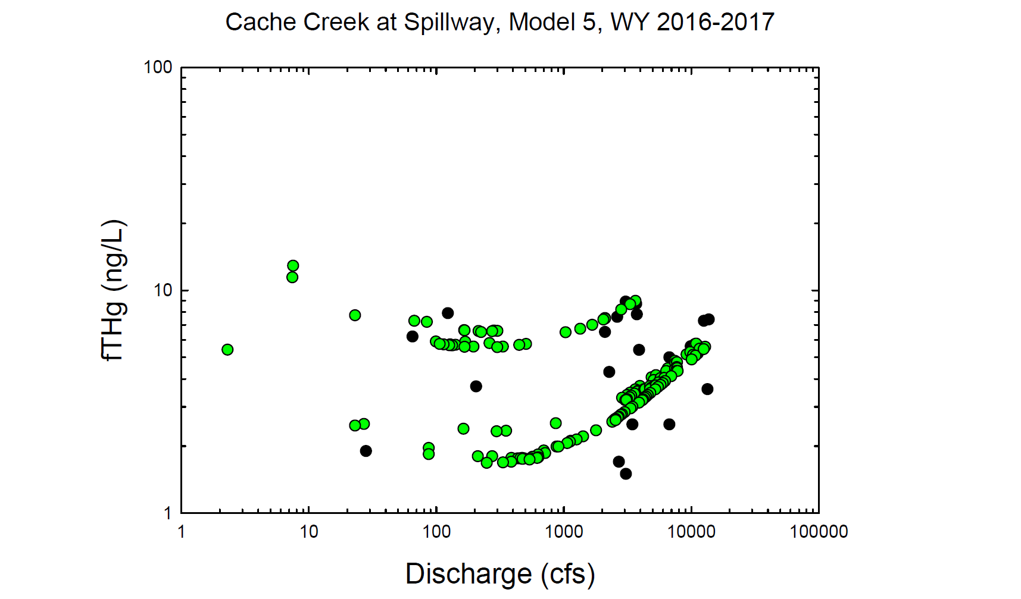
Black circles = Observed values
Green circles = Modeled values

Slide 24
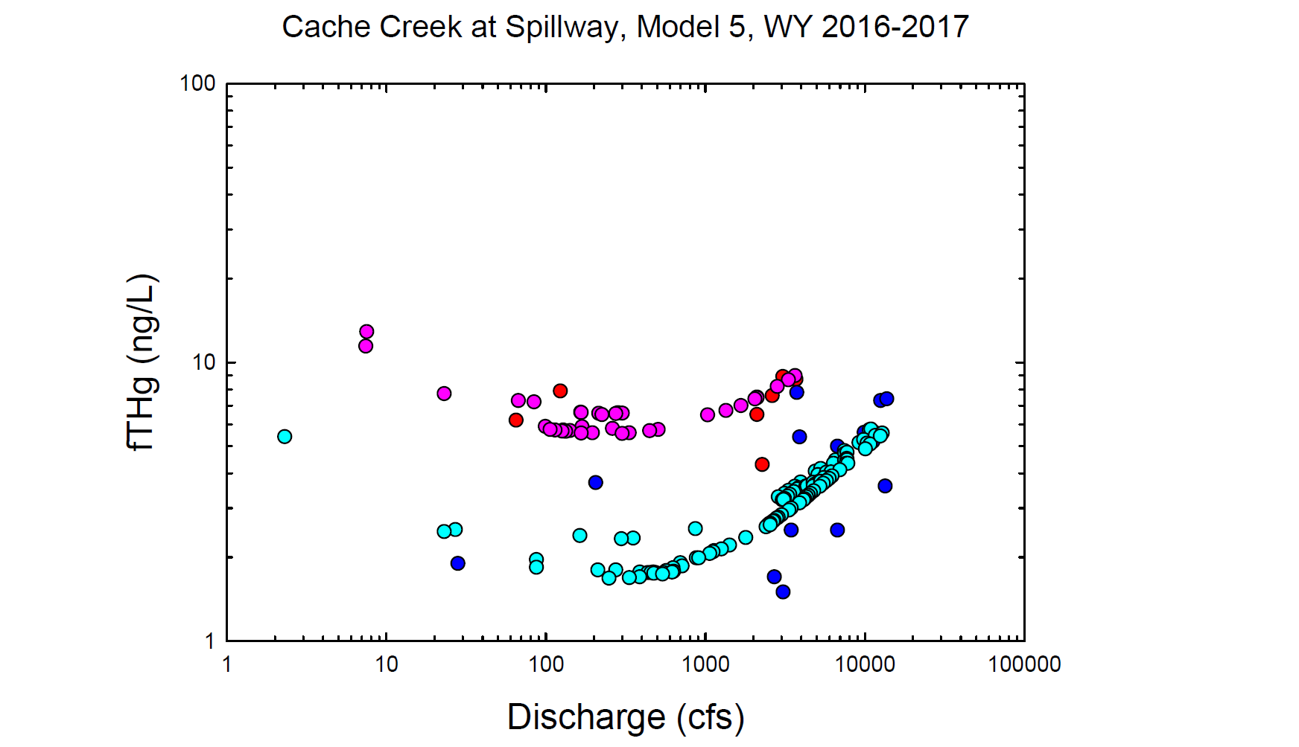
Red = Observed wy2016
Dk. Blue = Observed wy2017
Pink = Modeled wy2016
Lt. Blue= Modeled wy2017

Slide 25
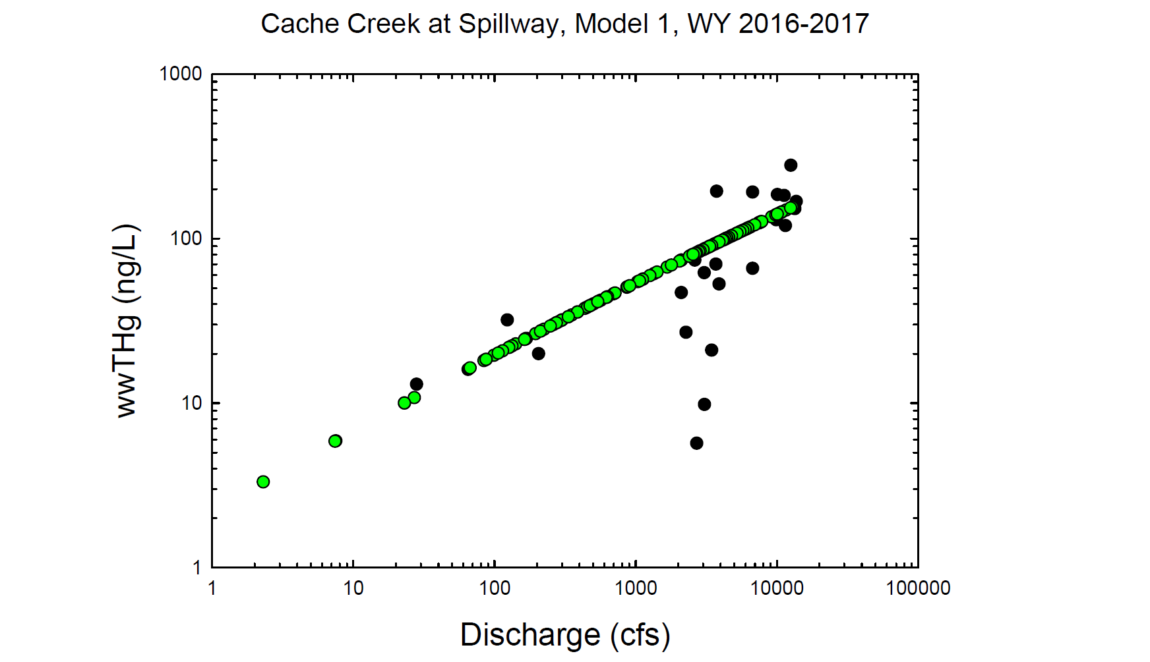
Black circles = Observed values
Green circles = Modeled values

Slide 26
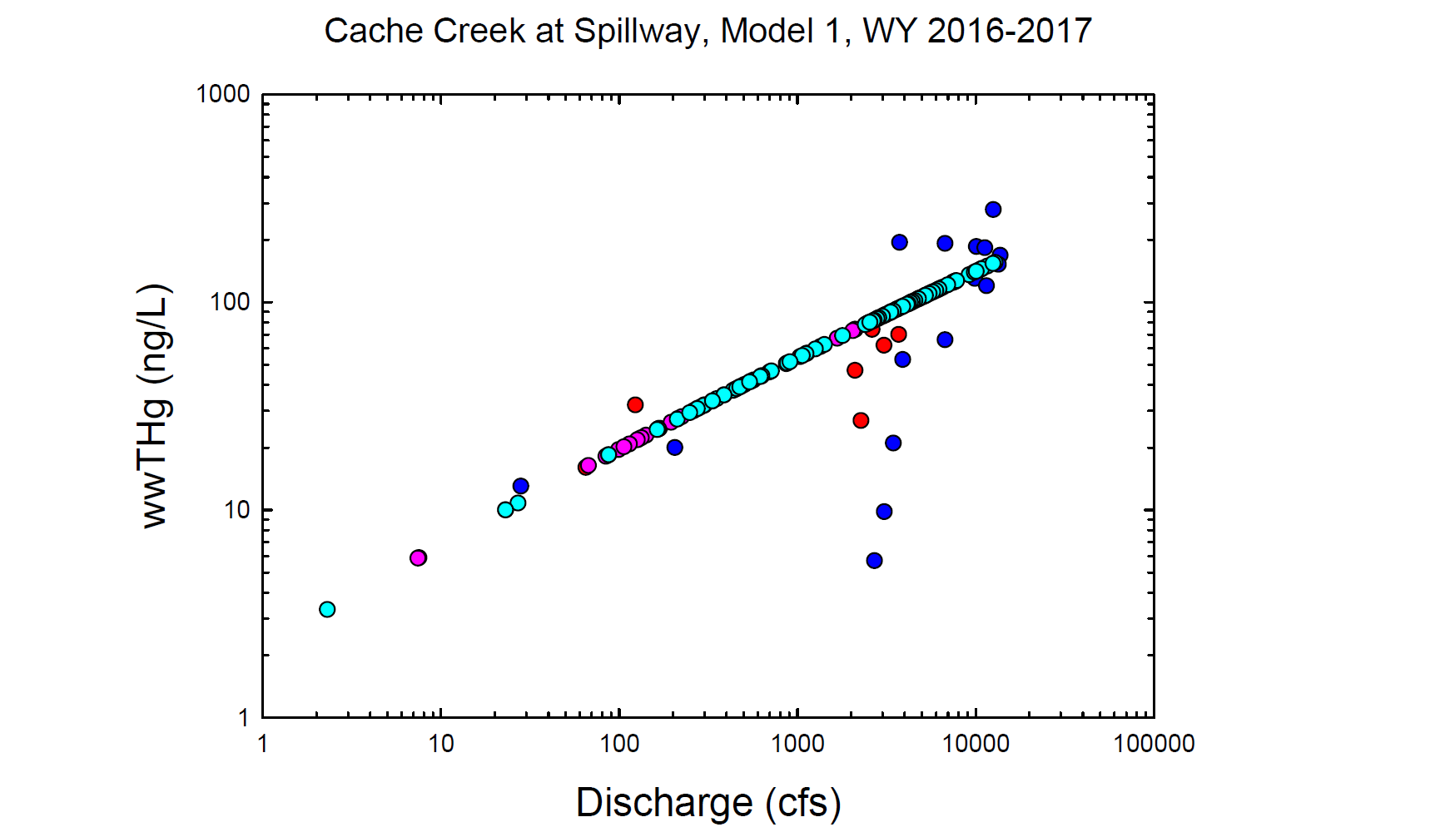
Red = Observed wy2016
Dk. Blue = Observed wy2017
Pink = Modeled wy2016
Lt. Blue= Modeled wy2017

Slide 27
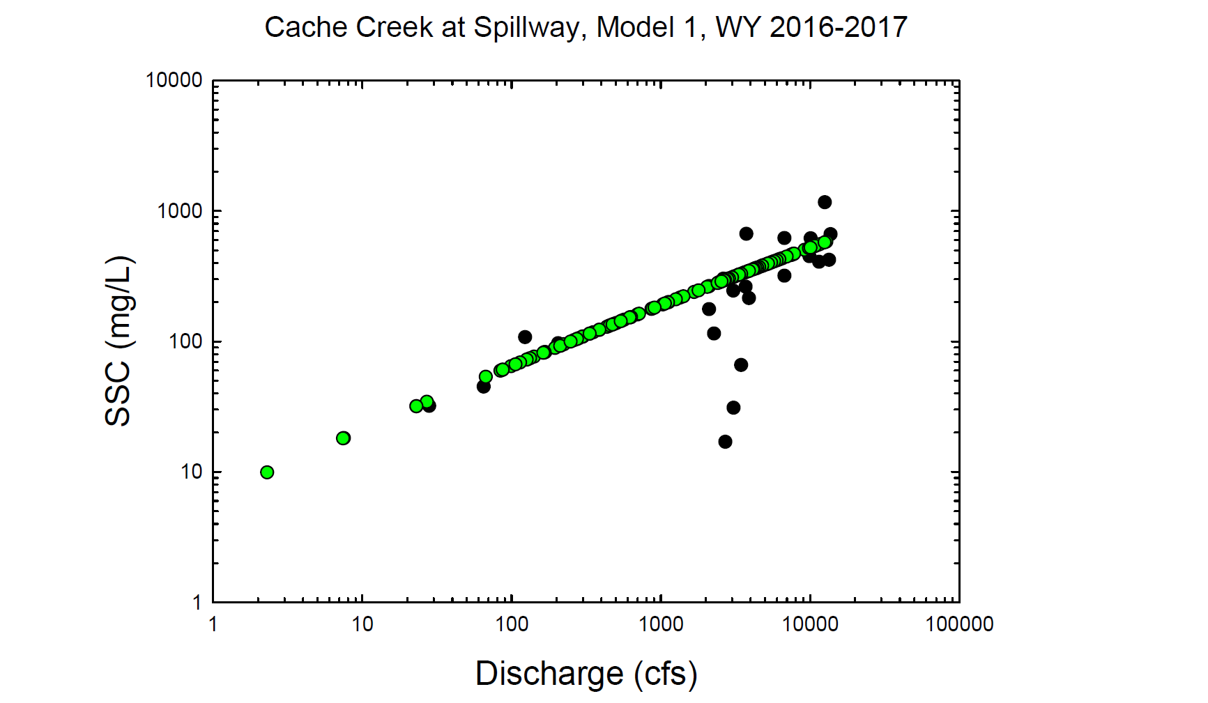
Black circles = Observed values
Green circles = Modeled values

Slide 28
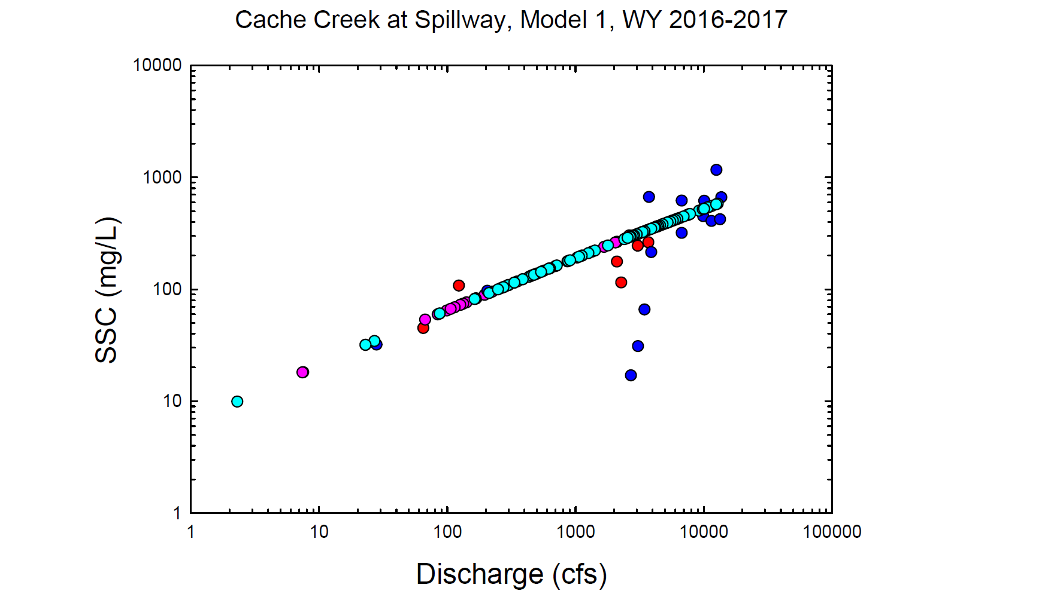
Red = Observed wy2016
Dk. Blue = Observed wy2017
Pink = Modeled wy2016
Lt. Blue= Modeled wy2017

Slide 29
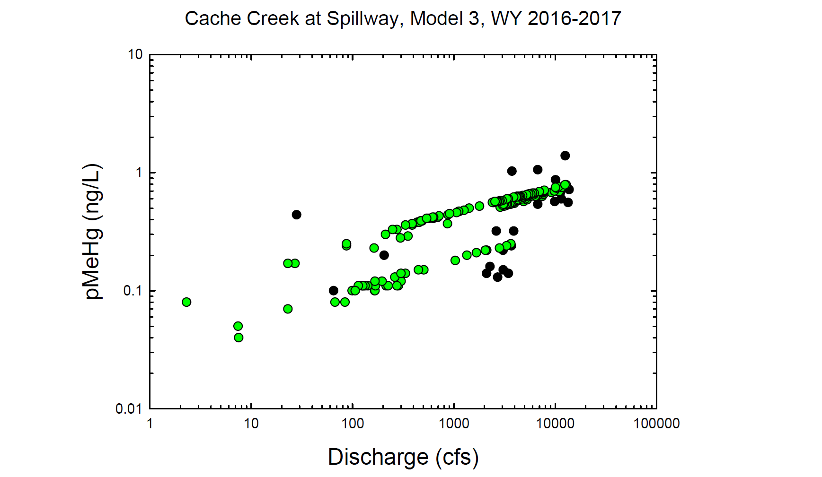
Black circles = Observed values
Green circles = Modeled values

Slide 30
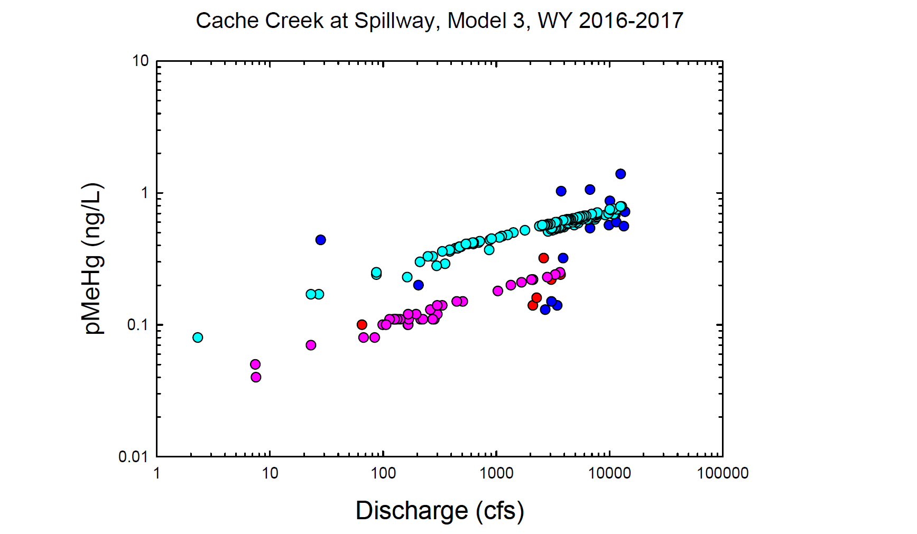
Red = Observed wy2016
Dk. Blue = Observed wy2017
Pink = Modeled wy2016
Lt. Blue= Modeled wy2017

Slide 31
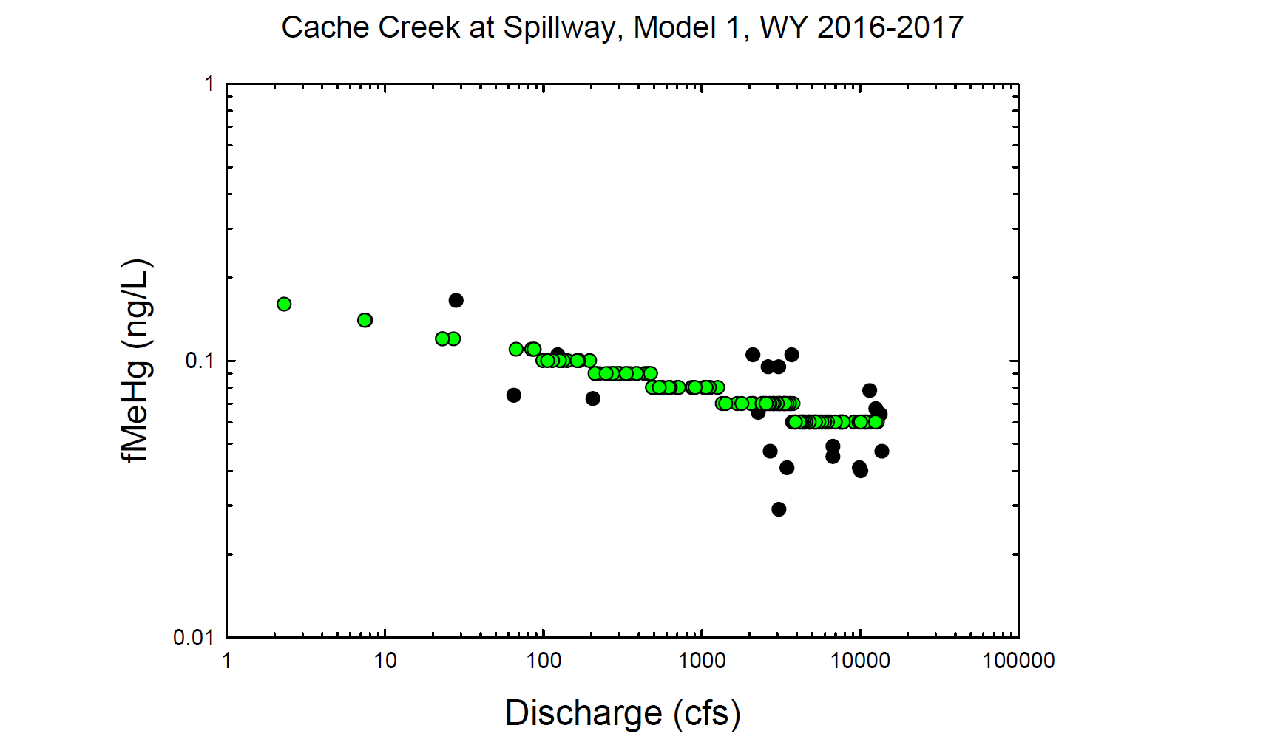
Black circles = Observed values
Green circles = Modeled values

Slide 32
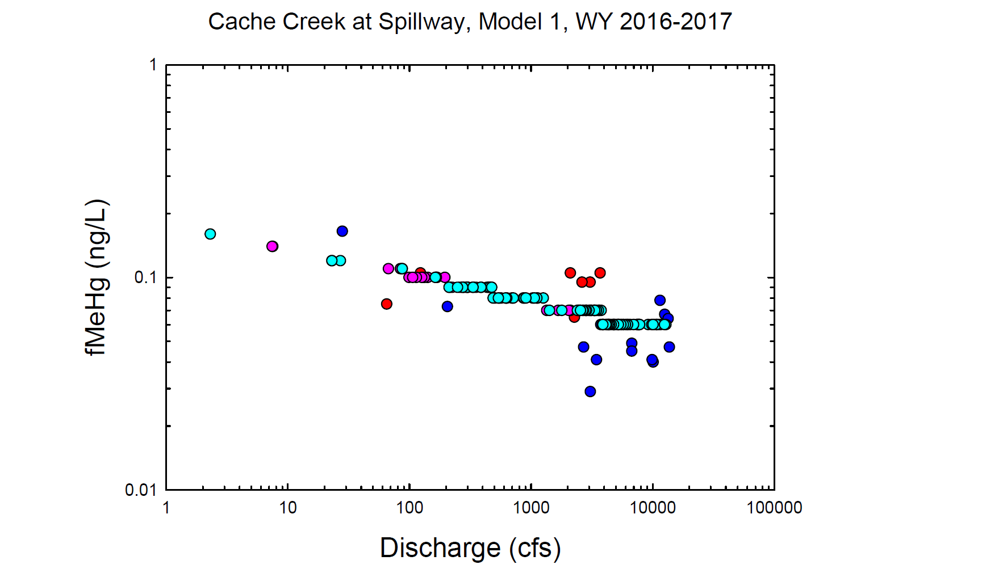
Red = Observed wy2016
Dk. Blue = Observed wy2017
Pink = Modeled wy2016
Lt. Blue= Modeled wy2017

Slide 33
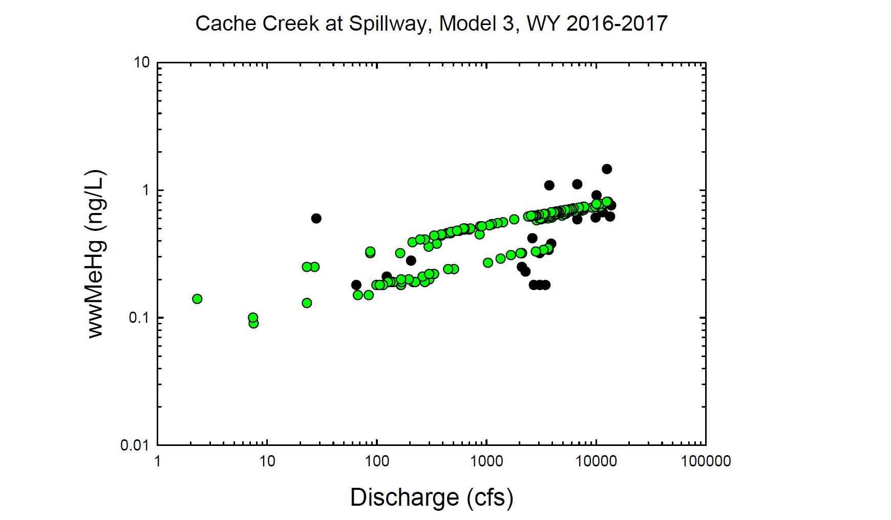
Black circles = Observed values
Green circles = Modeled values

Slide 34
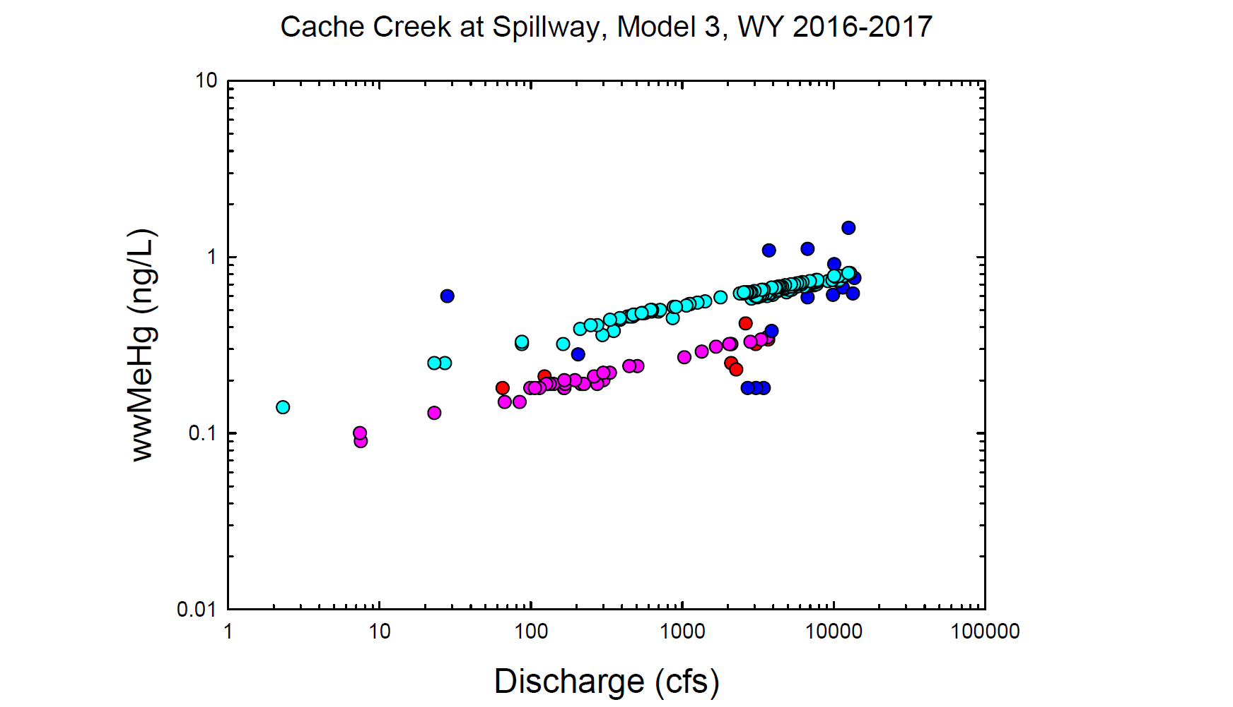
Red = Observed wy2016
Dk. Blue = Observed wy2017
Pink = Modeled wy2016
Lt. Blue= Modeled wy2017

Slide 35
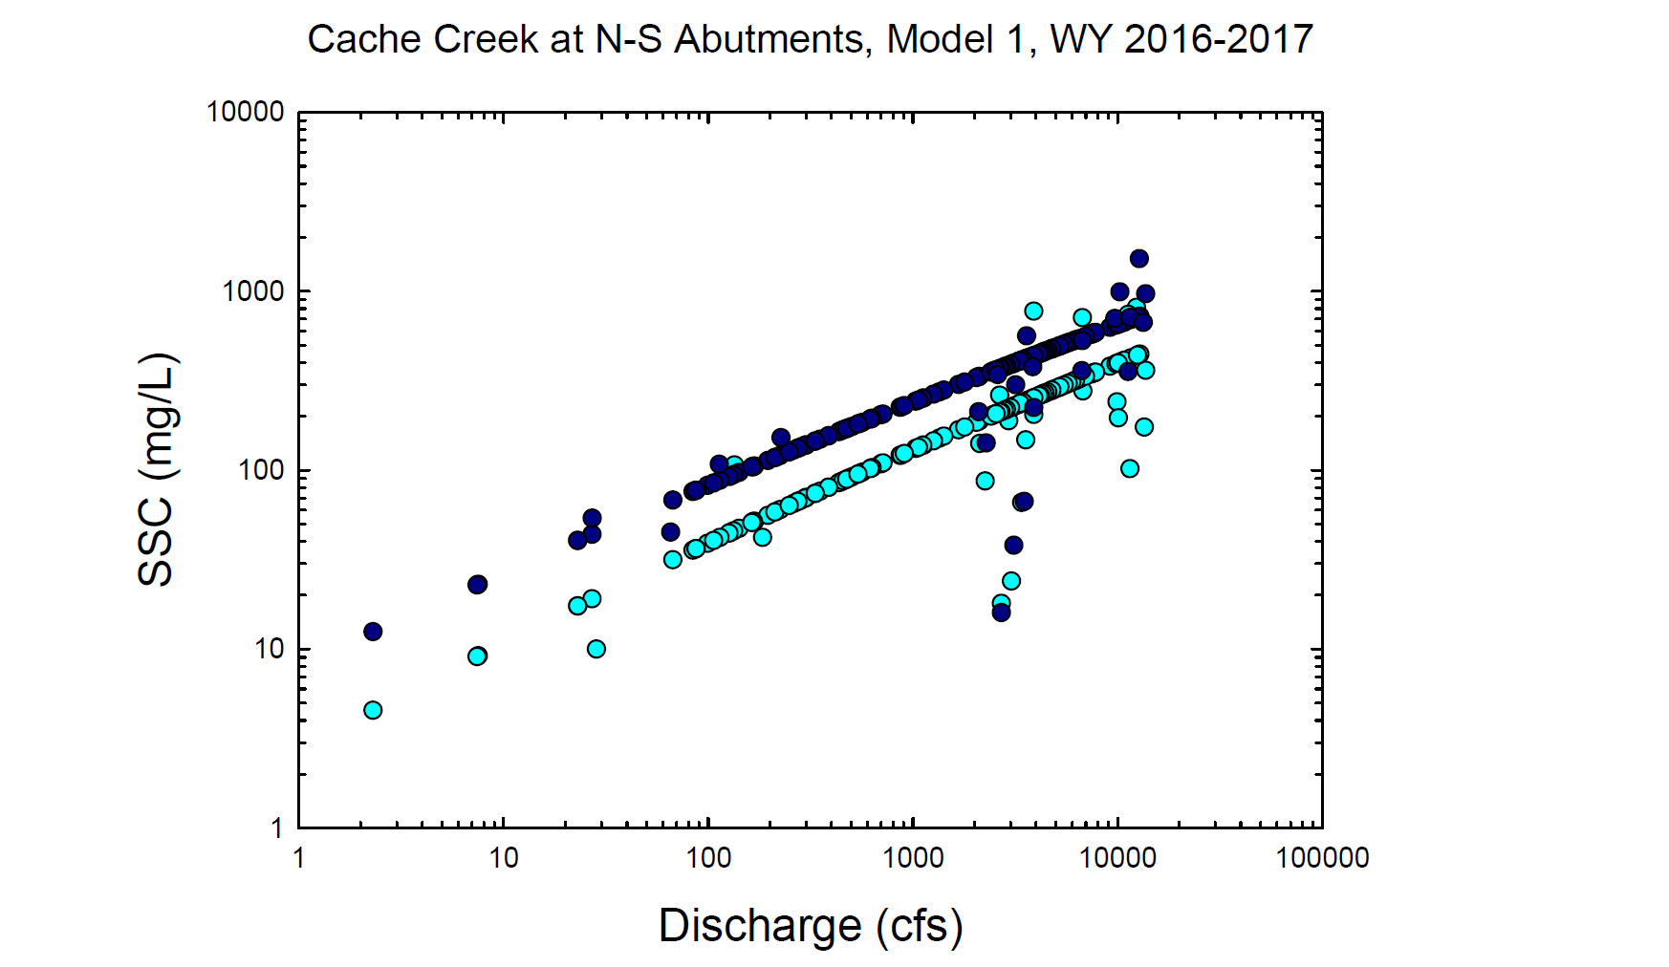
Lt Blue circles = Observed and Modeled values, North Abutment
Dk Blue circles = Observed and Modeled values, South Abutment

Slide 36
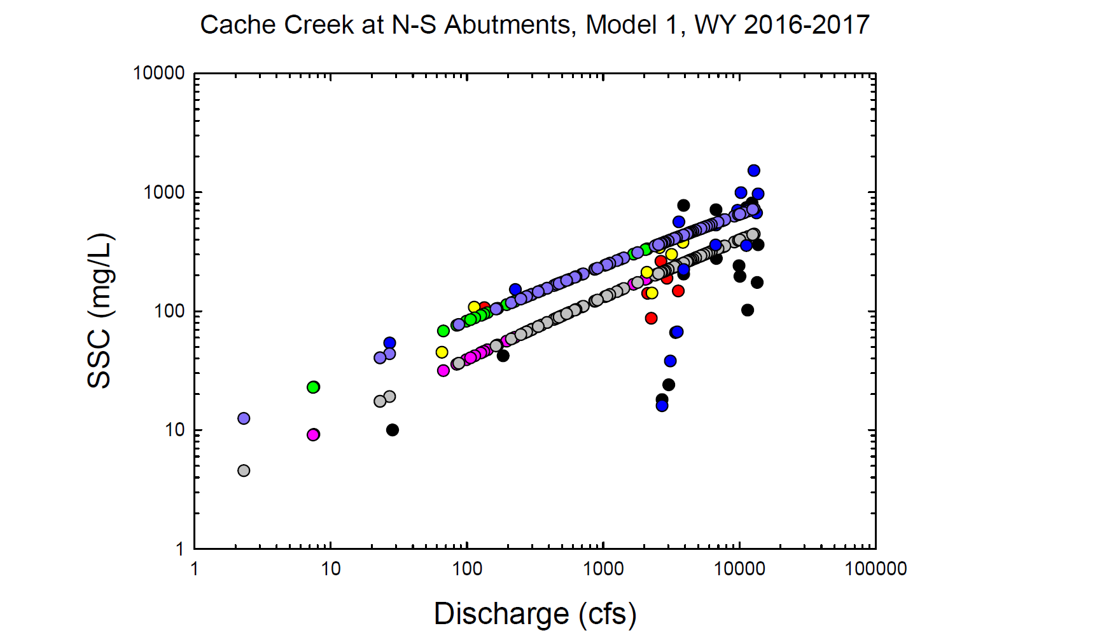
Red = Observed wy2016, N Abutment
Black = Observed wy2017, N Abutment
Pink = Modeled wy2016, N Abutment
Grey = Modeled wy2017, N Abutment
Yellow = Observed wy2016, S Abutment
Blue = Observed wy2017, S Abutment
Green = Modeled wy2016, S Abutment
Purple = Modeled wy2017, S Abutment

Slide 37
Black circles = Observed values
Green circles = Modeled values

Slide 38
Red = Observed wy2016
Dk. Blue = Observed wy2017
Pink = Modeled wy2016
Lt. Blue= Modeled wy2017

Slide 39
Black circles = Observed values
Green circles = Modeled values

Slide 40
Red = Observed wy2016
Dk. Blue = Observed wy2017
Pink = Modeled wy2016
Lt. Blue= Modeled wy2017

